Slide 1
Session Management in Servlet
Dr. Rajeshree Khande,
Associate Head, ,
School of Computer Science, MIT-WPU

Slide 2
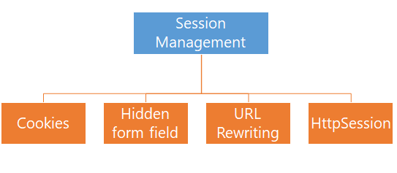
Session Management
HTTP is a stateless protocol.
All requests and responses are independent.
Sometimes we need to keep track of client's activity across multiple requests.
For eg. When a User logs into your website, not matter on which web page he visits after logging in, his credentials will be with the server, until he logs out. So this is managed by creating a session.
Session Management is a mechanism used by the Web container to store session information for a particular user.
When user starts using our application, we can save a unique identification information about him, in an object which is available throughout the application, until its destroyed.
Four different techniques used by Servlet application for session management.

Slide 3
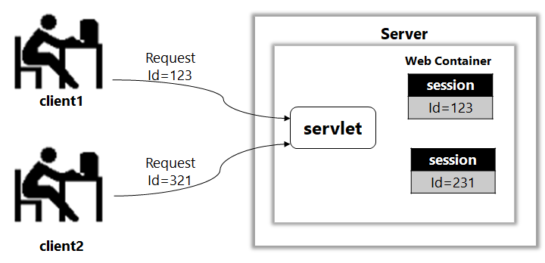
HTTPSession
On client's first request, the Web Container generates a unique session ID and gives it back to the client with response. This is a temporary session created by web container.
The client sends back the session ID with each request. Making it easier for the web container to identify where the request is coming from.
The Web Container uses this ID, finds the matching session with the ID and associates the session with the request

Slide 4
Session Management : HttpSession object
Used to store entire session with a specific client.
It stores information specific to a particular user across the whole application.
We can store, retrieve and remove attribute from HttpSession object.
Any servlet can have access to HttpSession object throughout the getSession() method of the HttpServletRequest object.
When a user enters into a website for the first time HttpSession is obtained with the help of request.getSession(), the user is given a unique ID to identify his session.
This unique ID can be stored into a cookie or in a request parameter.

Slide 5
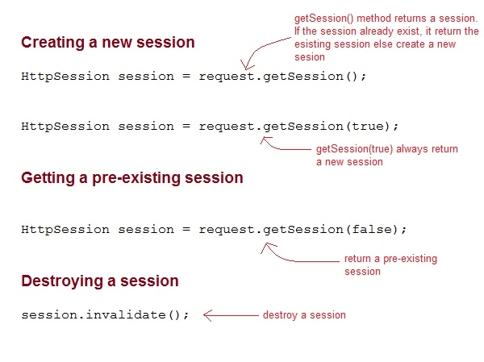
Creating Session

Slide 6
Servlet1.java
Display uname & pwd
Create session
Store uname & pwd in session
Username
password
Servlet2.java
read the session info
Display session info
Login.html
---
Uname
pawd

Slide 7
Some Important Methods of Servlet HttpSession
Methods | Description
long getCreationTime() | returns the time when the session was created, measured in milliseconds since midnight January 1, 1970 GMT.
String getId() | returns a string containing the unique identifier assigned to the session.
long getLastAccessedTime() | returns the last time the client sent a request associated with the session
int getMaxInactiveInterval() | returns the maximum time interval, in seconds.
void invalidate() | destroy the session
boolean isNew() | returns true if the session is new else false
void setMaxInactiveInterval(int interval) | Specifies the time, in seconds,after servlet container

Slide 8
Methods of HttpSession
public void setAttribute(String name, Object value):
Binds the object with a name and stores the name/value pair as an attribute of the HttpSession object. If an attribute already exists, then this method replaces the existing attributes.
2. public Object getAttribute(String name):
Returns the String object specified in the parameter, from the session object. If no object is found for the specified attribute, then the getAttribute() method returns null.

Slide 9
Deleting Session Data
Remove a particular attribute:
public void removeAttribute(String name)
Delete the whole session
public void invalidate()
Setting Session timeout
public void setMaxInactiveInterval(int interval)
web.xml Configuration − If you are using Tomcat, apart from the above mentioned methods, you can configure session time out in web.xml file as follows.
<session-config>
<session-timeout>15</session-timeout>
</session-config>

Slide 10
Cookies for Session Management in Servlet
Recall few things here from HttpSession .
When a user visits web application first time, the servlet container crates new HttpSession object by calling request.getSession().
A unique Id is assigned to the session.
The Servlet container also sets a Cookie in the header of the HTTP response with cookie name and the unique session ID as its value.
Cookies are small pieces of information that are sent in response from the web server to the client.
Cookies are the simplest technique used for storing client state.

Slide 11
Cookies for Session Management in Servlet
The cookie is stored in the user browser, the client (user’s browser) sends this cookie back to the server for all the subsequent requests until the cookie is valid.
The Servlet container checks the request header for cookies and get the session information from the cookie and use the associated session from the server memory.
The session remains active for the time specified in tag in web.xml. If tag in not set in web.xml then the session remains active for 30 minutes.
Cookie remains active as long as the user’s browser is running, as soon as the browser is closed, the cookie and associated session info is destroyed.
So when the user opens the browser again and sends request to web server, the new session is being created.

Slide 12
Types of Cookies
Types of Cookies
Session
Persistent
Do not have expiration time. It lives in the browser memory. As soon as the web browser is closed this cookie gets destroyed.
Unlike Session cookies they have expiration time, they are stored in the user hard drive and gets destroyed based on the expiry time.

Slide 13
How to send Cookies to the Client
1.
Create a Cookie object
Cookie c = new Cookie("userName",“Rajeshree");
3 steps
2.
Set the maximum Age.
c.setMaxAge(1800);
3.
Place the Cookie in HTTP response header.
send the cookie to the client browser through method.
response.addCookie(c);

Slide 14
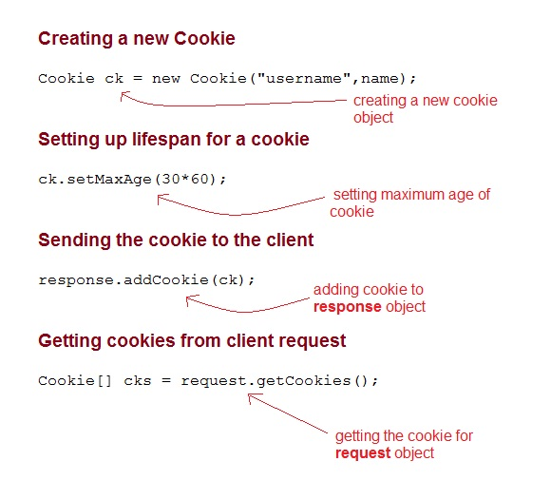
Servlet: Cookies API

Slide 15
How to read cookies
read cookies
Delete cookies
Cookie[] c =request.getCookies();
//c.length gives the cookie count
for(int i=0;i<c.length;i++)
{
out.print("Name: "+c[i].getName()+" & Value: "+c[i].getValue());
}
Cookie cookies[] = request.getCookies();
out.print("Deleted cookie are:");
for(Cookie cookie : cookies)
{
cookie.setMaxAge(0);
out.println("Cookie name: " + cookie.getName());
}

Slide 16
Example
Login.html
Login.html
CreateCookies.java
ReadCookies.java
DeleteCookies.java
<body>
<form action="CreateCookies" method="post">
User Name:<input type="text" name="uname"/><br/>
Password:<input type="password" name="pwd"/><br/>
<input type="submit" value="submit"/>
</form>
</body>

Slide 17
Example
protected void doPost(HttpServletRequest request, HttpServletResponse response) throws ServletException, IOException {
// TODO Auto-generated method stub
doGet(request, response);
response.setContentType("text/html");
PrintWriter out = response.getWriter();
String name = request.getParameter("uname");
String password = request.getParameter("pwd");
out.println("Hello "+name);
out.println("Your Password is: "+password);
//Creating two cookies
Cookie c1=new Cookie("userName",name);
Cookie c2=new Cookie("userPassword",password);
//Adding the cookies to response header
response.addCookie(c1);
response.addCookie(c2);
out.print("<h3>Cookies are created. Click on the " + "below button to get cookies.");
out.println("<hr>" + "</hr>");
out.print("<form action='servlet2' method='POST'>");
out.print("<input type='submit' value='Get Cookie'>");
out.print("</form>");
out.close();
} }
CreateCookies.java

Slide 18
Example
protected void doPost(HttpServletRequest request, HttpServletResponse response) throws ServletException, IOException {
// TODO Auto-generated method stub
doGet(request, response);
response.setContentType("text/html");
PrintWriter out = response.getWriter();
//Reading cookies
Cookie[] c =request.getCookies();
out.println("<h3>"+ "Displaying User name value from cookie" + "</h3>");
out.println("<h4>");
out.println("Name: "+c[0].getValue() + " ");
out.print("Password: "+c[1].getValue());
out.println("</h4>");
out.println("<hr>" + "</hr>");
out.print("<form action='DeleteCookie' method='POST'>");
out.print("<input type='submit' value='Delete Cookies'>");
out.print("</form>");
} }
ReadCookies.java

Slide 19
Example
protected void doPost(HttpServletRequest request, HttpServletResponse response) throws ServletException, IOException {
// TODO Auto-generated method stub
doGet(request, response);
response.setContentType("text/html");
PrintWriter out = response.getWriter();
try{
Cookie cookies[] = request.getCookies();
out.println("<h3>");
out.print("Deleted cookie are:");
out.println("<br>" + "</br>");
for(Cookie cookie : cookies)
{
cookie.setMaxAge(0);
out.println("Cookie name: " + cookie.getName());
out.println("<br>" + "</br>");
}
out.println("</h3>");
out.close();
}
catch(Exception e){
e.printStackTrace();
}
} }
DeleteCookies.java

Slide 20
Servlet: Cookies Method
Methods | Description
public String getName( ) | Returns the name of the cookies.
public String getPath( ) | Returns the path of the server to which the browser returns the cookie.
public String getValue( ) | Returns the value of the cookie.
public int getMaxAge( ) | Returns the maximum age limit to the cookie, specified in seconds.
public void setMaxAge(int expiry) | Sets the maximum age of the cookies in seconds.
public void setValue(String newValue) | Allocates a new value to a cookie after the cookie is created.

Slide 21
Advantages & Disadvantages
Advantages of cookies
They are stored on client side so don’t need any server resource.
Easy technique for session management.
Disadvantages of cookies
Cookies can be disabled from the browser.
Security risk is there because cookies exist as a text file so any one can open and read user’s information.

Slide 22
Using URL Rewriting for Session Management
If the client has disabled cookies in the browser then session management using cookie wont work.
In that case URL Rewriting can be used as a backup.
URL rewriting is a way of appending data at the end of URL.
Data is appended in name value pair form.
Multiple parameters can be appended in one URL with name value pairs.
Syntax
URL?param1=Value1&param2=Value2

Slide 23
Reading data from URL
getParameter() method is used to get parameter value from url in servlet.
Syntax
String value = request.getParameter(“fieldName”);

Slide 24
Advantage & Disadvantages
Advantages | Disadvantages
As data is appended in the URL it is easy to debug. It is browser independent. | Not secure because data is appended in the URL. Can’t append large no. of parameters because URL length is limited. Data is limited to 2 KB length

Slide 25
Using URL Rewriting for Session Management
When the User clicks on the URL having parameters, the request goes to the Web Container with extra bit of information at the end of URL.
The Web Container will fetch the extra part of the requested URL and use it for session management.
The getParameter() method is used to get the parameter value at the server side.
Index.html
Web.xml
Servlet1.java
Servlet2.java

Slide 26
Index.html
<form method="post" action="validate">
Name:<input type="text" name="user" /><br/>
Password:<input type="text" name="pass" ><br/>
<input type="submit" value="submit">
</form>

Slide 27
Servlet1.java
import java.io.*;
import javax.servlet.*;
import javax.servlet.http.*;
public class MyServlet extends HttpServlet {
protected void doPost(HttpServletRequest request, HttpServletResponse response)
throws ServletException, IOException {
response.setContentType("text/html");
String name = request.getParameter("user");
String pass = request.getParameter("pass");
if(pass.equals("1234"))
{
response.sendRedirect("First?user_name="+ name);
}
}
}

Slide 28
Servlet2.java
import java.io.*;
import javax.servlet.*;
import javax.servlet.http.*;
public class First extends HttpServlet {
protected void doGet(HttpServletRequest request, HttpServletResponse response)
throws ServletException, IOException {
response.setContentType("text/html");
PrintWriter out = response.getWriter();
String user = request.getParameter("user_name");
out.println("Welcome "+user);
}
}

Slide 29
Hidden Form Field for Session Management
Hidden form field can also be used to store session information for a particular client.
In this case user information is stored in hidden field value and retrieved from another servlet.
Advantages | Disadvantages
All browsers support hidden fields. Inserting a simple HTML Input field of type hidden is required. Easier to implement. | Not secure Only work in case of form submission. Extra form submission is required on every page. This is a big overhead.

Slide 30
Example: Hidden Form Field
login.html
login.html
SetHiddenField.java
GetHiddenFiled.java
<form action="SetHiddenField" method="post">
Username:<input type="text" name="uname"/>
<br/><br/>
Password:<input type="password" name="password"/>
<br/><br/>
<input type="submit" value="login"/>
</form>

Slide 31
SetHiddenField.java
protected void doPost(HttpServletRequest request, HttpServletResponse response) throws ServletException, IOException {
// TODO Auto-generated method stub
doGet(request, response);
response.setContentType("text/html");
PrintWriter out = response.getWriter();
String username = request.getParameter("uname");
String password = request.getParameter("password");
if(username == null || username.equals("") || password == null || password.equals(""))
{
out.print("Please enter both username " + “ and password. <br/><br/>");
RequestDispatcher rd = request.getRequestDispatcher("/Login.html");
rd.include(request, response);
}
else if(username.equals("admin") && password.equals("123"))
{
out.println("Logged in successfully.<br/>");
out.println("Click on the below button to Read Hidden Field");
out.print("<form action='GetHiddenField'" + " method='POST'>");
out.print("<input type='hidden' name='username' value= 'username'>");
out.print("<input type='hidden' name='password' value='password'>");
out.print("<input type='submit' value='Read Values'>");
out.print("</form>");
out.close();
}

Slide 32
GetHiddenField.java
protected void doPost(HttpServletRequest request, HttpServletResponse response) throws ServletException, IOException {
// TODO Auto-generated method stub
doGet(request, response);
response.setContentType("text/html");
PrintWriter out = response.getWriter();
String u1 = request.getParameter("username");
String p1 = request.getParameter("password");
out.println("Username: " + u1 + "<br/><br/>");
out.println("Password: " + p1);
out.close();
}

Slide 33
Additional Reading : Get vs. Post Request
Feature | GET | POST
Sending of data | Client data is appended to URL and sent | Client data is sent separately
Storing in the Browser History | As data is appended, the client data is stored in the browser history | As data is sent separately, the client data is not stored in the browser history
Bookmark | The URL with client data can be bookmarked. Thereby, later without filling the HTML form, the same data can be sent to server | Not possible to bookmark
Limitation of data sent | Limited to 2048 characters (browser dependent) | Unlimited data
Security | Easy to hack the data as the data is stored in the browser history | Difficult to hack as the data is sent separately in an HTML form
Type of data sent | Only ASCII data can be sent | Any type of data can be sent including the binary data
Data secrecy | Data is not secret as other people can see the data in the browser history | Data is secret as not stored in the browser history
When to be used | Prefer when data sent is not secret. Do not use for passwords etc. | Prefer for critical and sensitive data like passwords etc.
Cache | Can be caught | Cannot be caught
Default | If not mentioned, GET is assumed as default | Should be mentioned explicitly
Performance | Relatively faster as data is appended to URL | A separate message body is to be created

Slide 34

Session Management
Session is used to store everything that we can get from the client from all the requests the client makes.
Server
Request
Id=123
Web Container
session
Id=123
client1
servlet
Request
Id=321
session
Id=231
client2

